Slide 1
Reading Cloud

Slide 2
Reading Cloud
You can now access the school's library resources anytime with Reading Cloud.
With Reading Cloud you can:
Check your library account and renew books
Search the catalogue and reserve library resources online at any time
Find out about your favorite authors and their books
View the newest arrivals and most popular books
View recommended reads with Who Next
Write and share reviews

Slide 3
Getting started

Slide 4
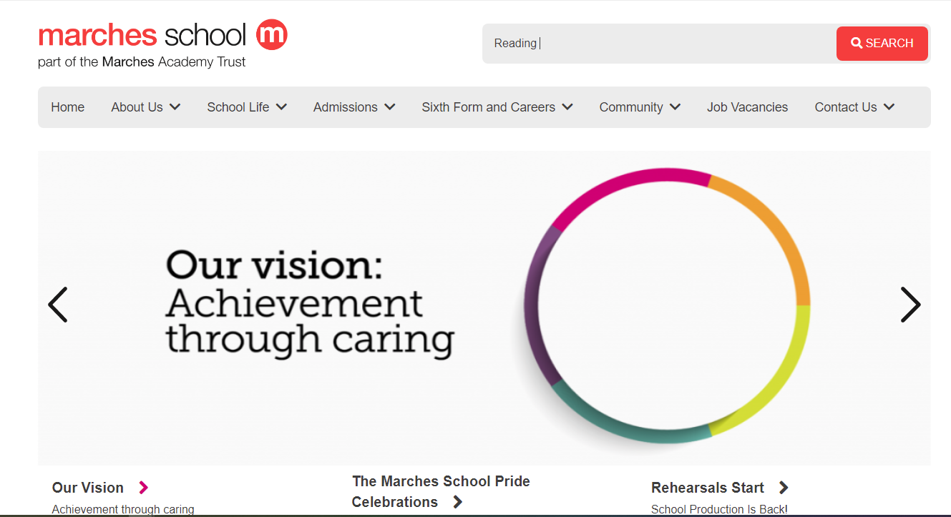
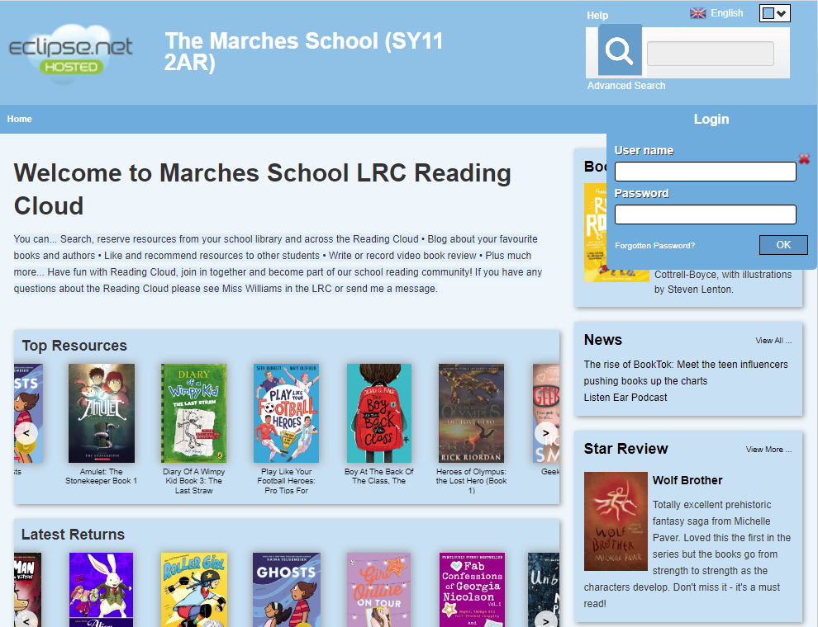
Logging into Reading Cloud
Go to the Marches School Home page and search Reading school
or go to http://u021529.microlibrarian.net
Your form tutor has all your login details.
Password: Your date of birth in 8 digits.
e.g. 1st January 2010 is 01012010

Slide 5
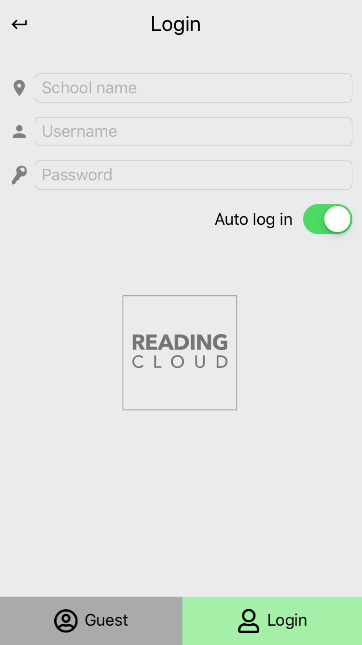
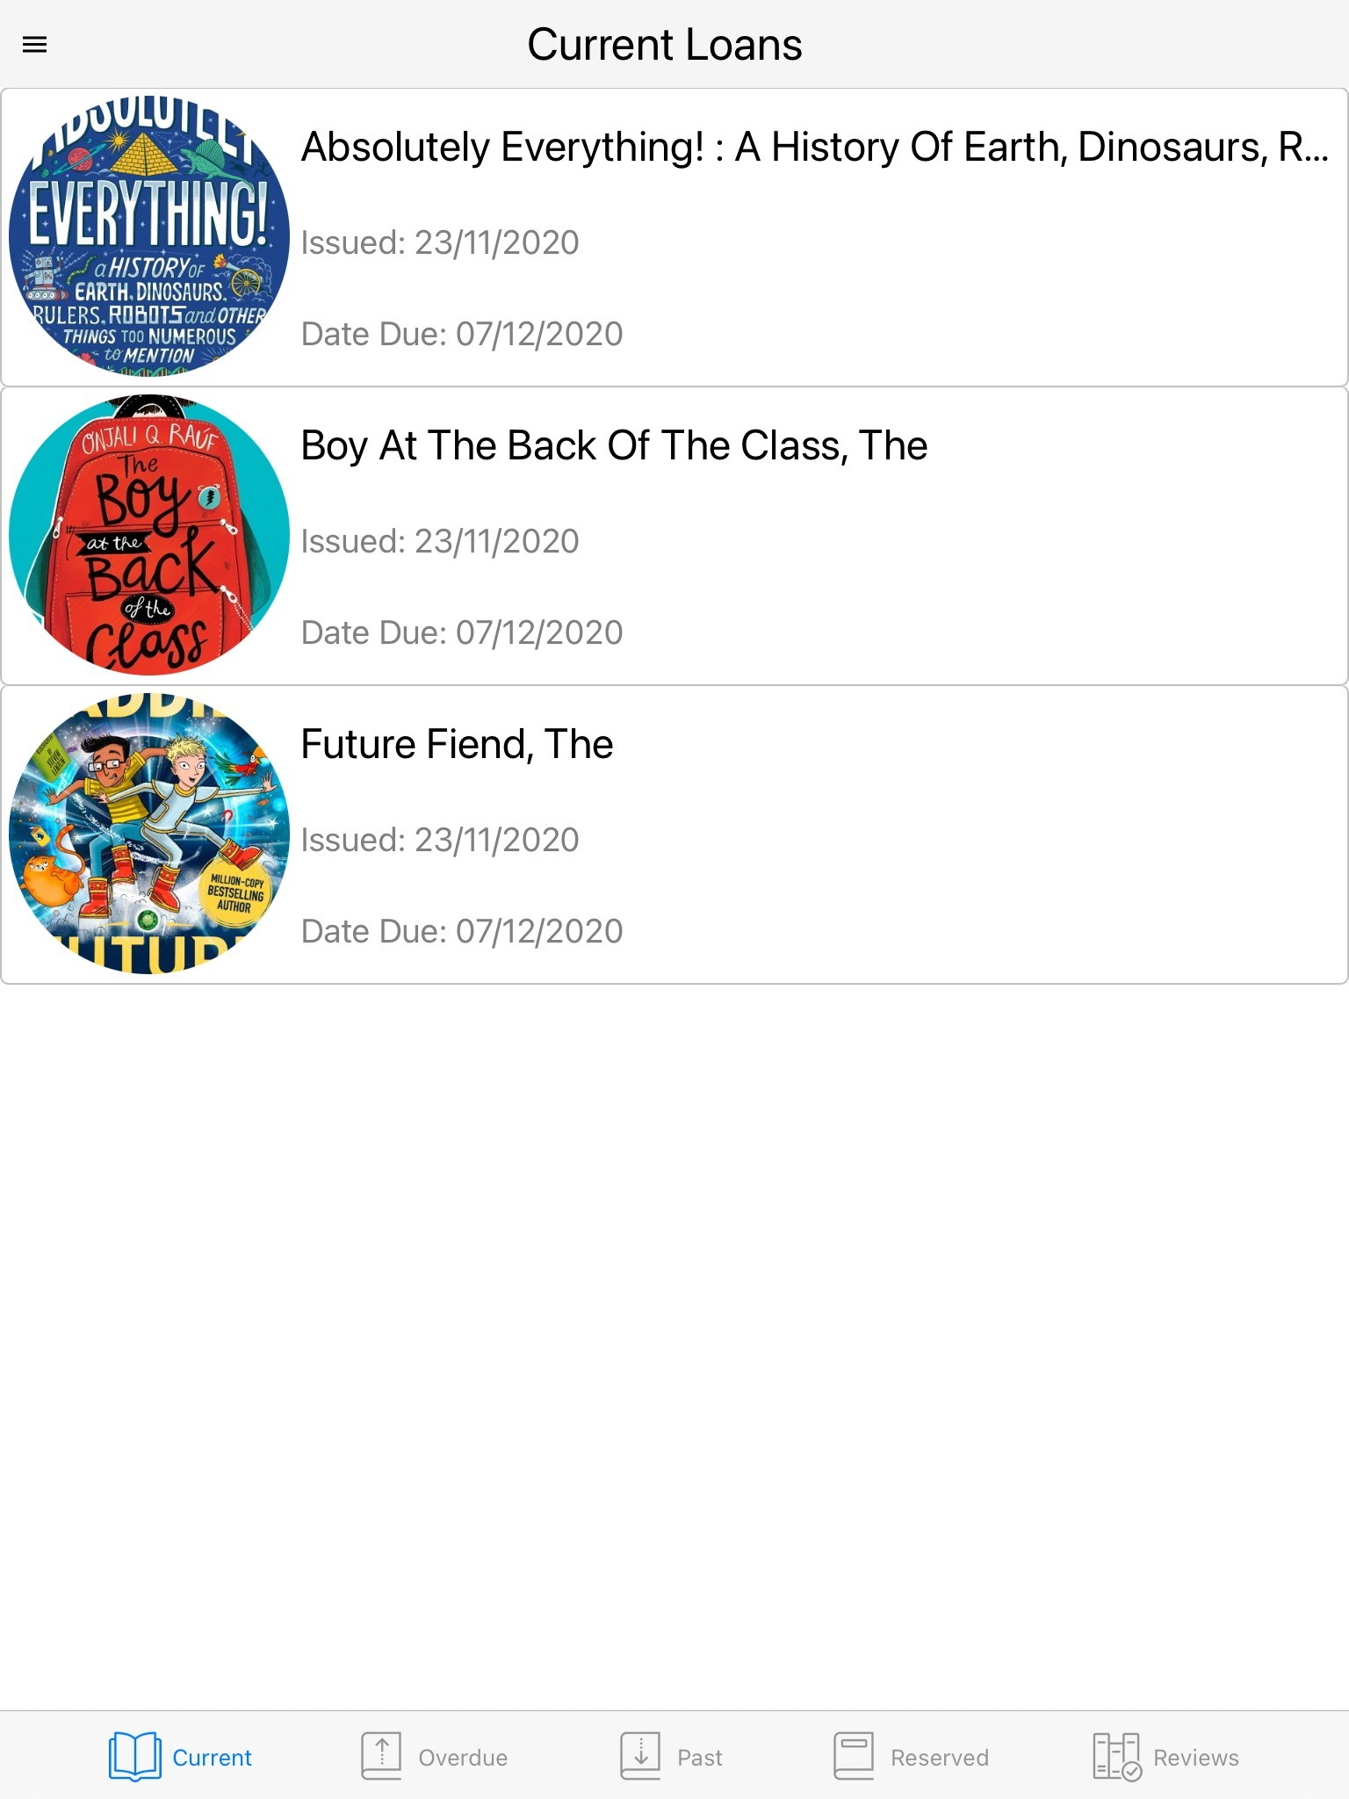
Logging in using the App
You can also download the Reading Cloud App to your phone. Just visit the App Store or Android market.
Once you have logged into your library account you will find a menu listing all you can do with the app and it’s easy to find your way around.

Slide 6
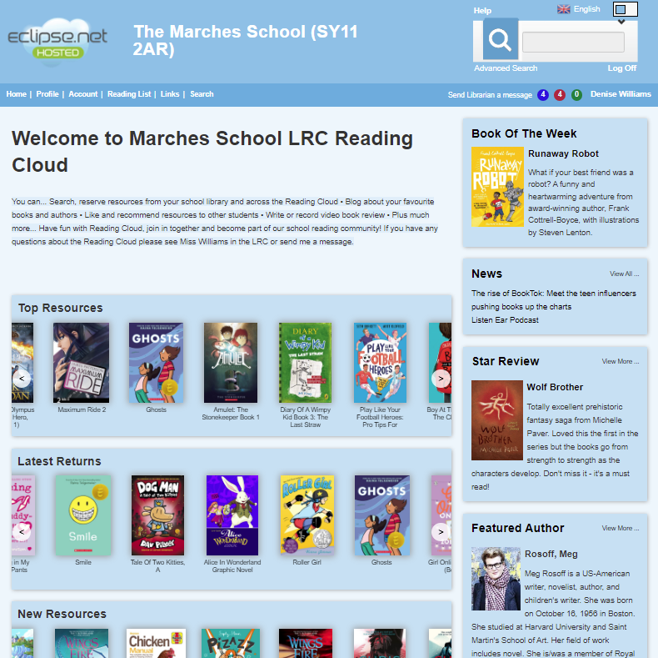
Search for fiction, non-fiction books, authors and subjects
Reading Cloud
Not too sure what to read next. Have a look at some suggested reading lists.
Discover new authors.

Slide 7
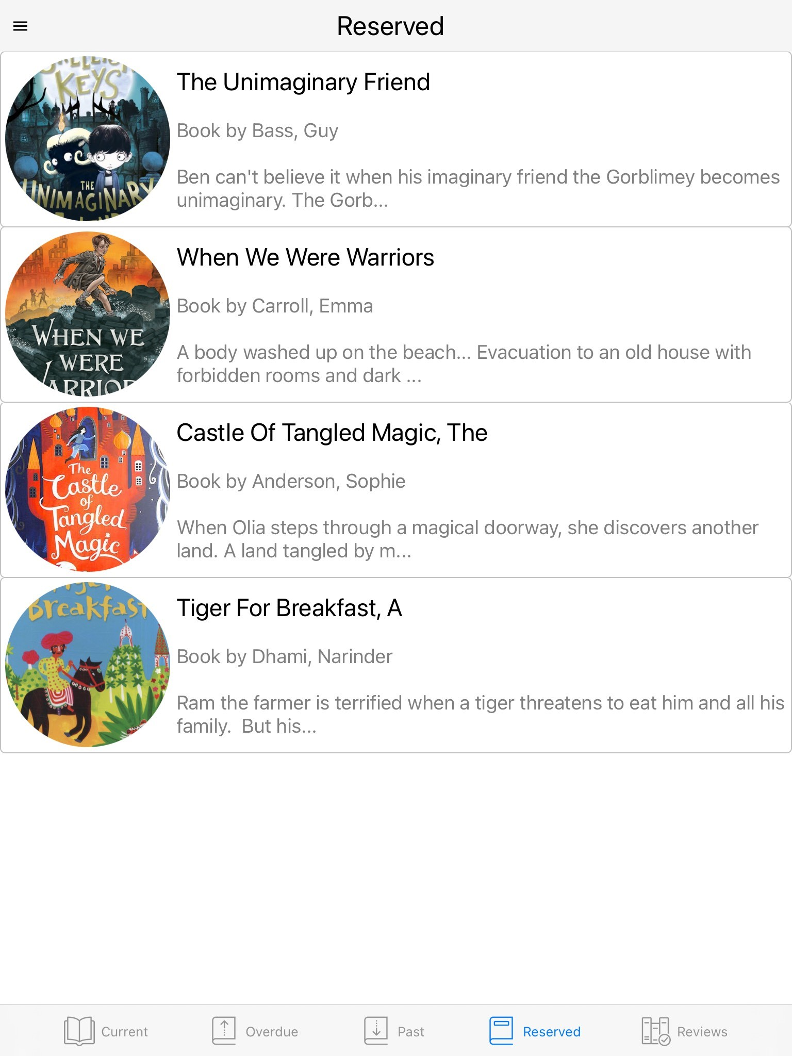
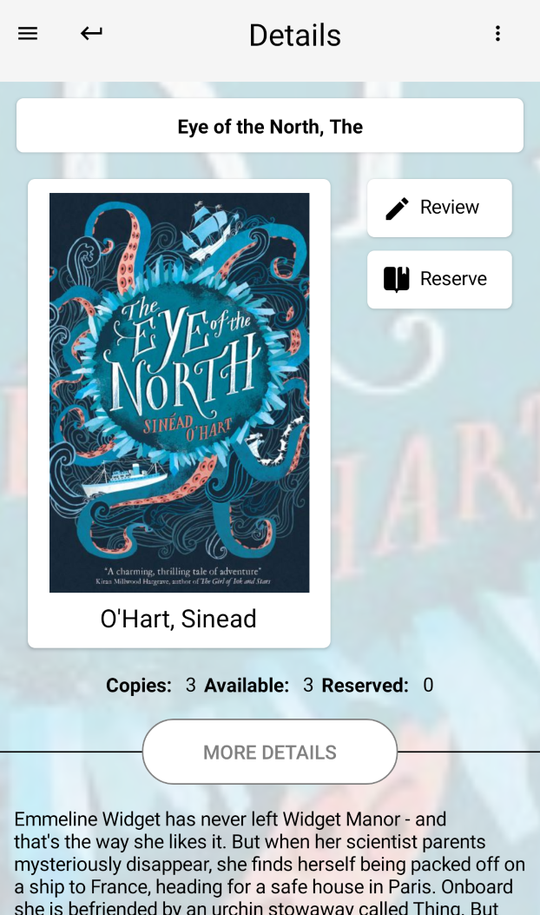
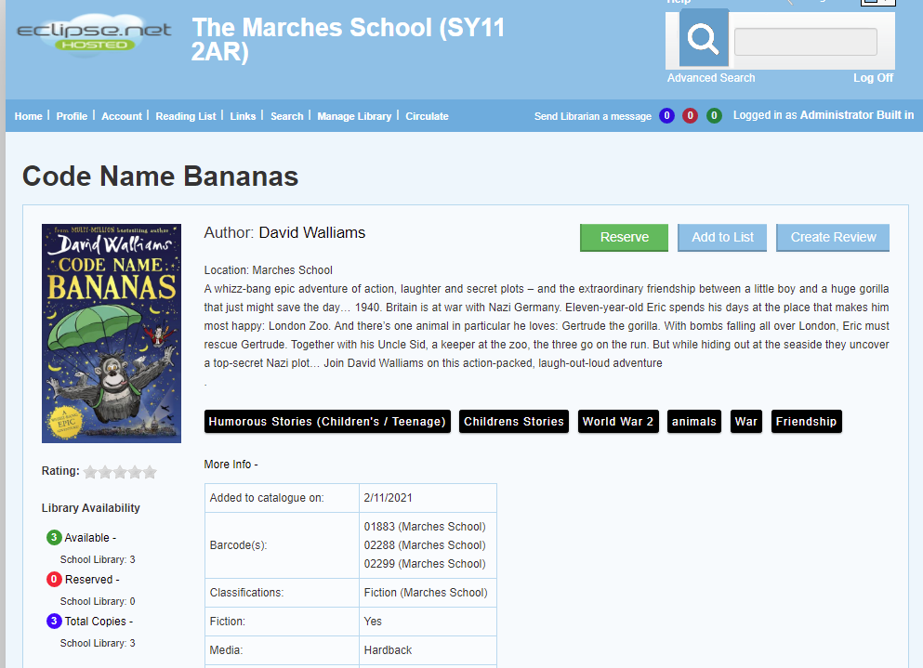
Reserving a book
Can't get to the library?
The library will come to you.
You now can see how many books are available in the library and reserve a copy.
Your book will be drop off at your form room.
APP
All your reservations are shown in My Account.
Desktop
Make sure there are copies available

Slide 8
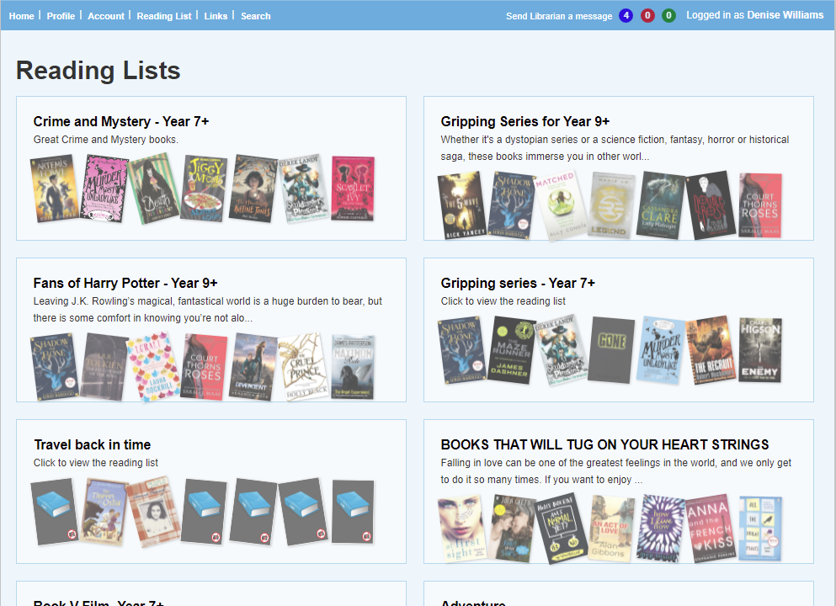
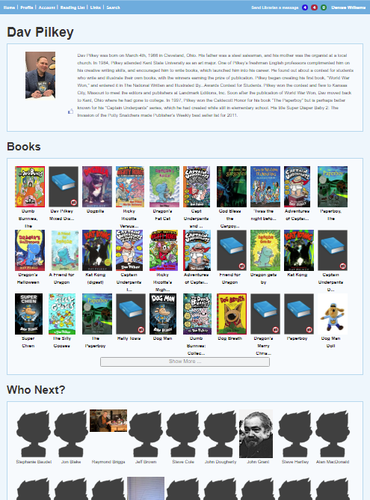
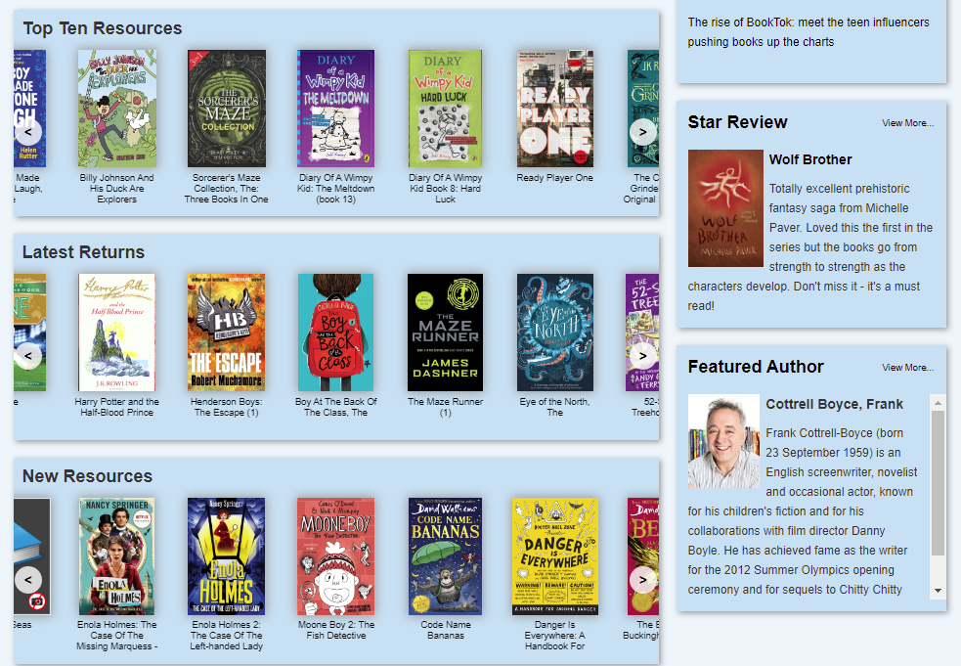
Reading Lists and much more…
Need ideas on what to read next?
Check out the Reading lists,
Top Ten Resources, Featured Authors or New Resources
for some ideas.

Slide 9
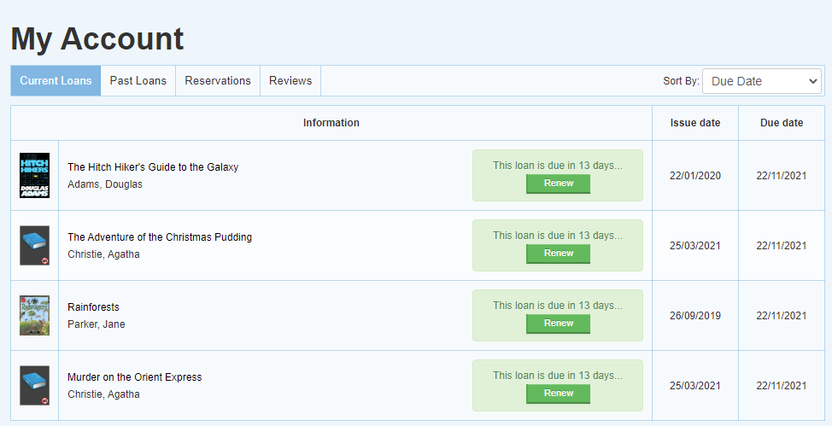
Renewing books online
Account - Shows current and past loans and any reservations made.
You can also renew your books providing they are not already overdue.
Currently, you are unable to renew a book with the Reading Cloud App.

Slide 10
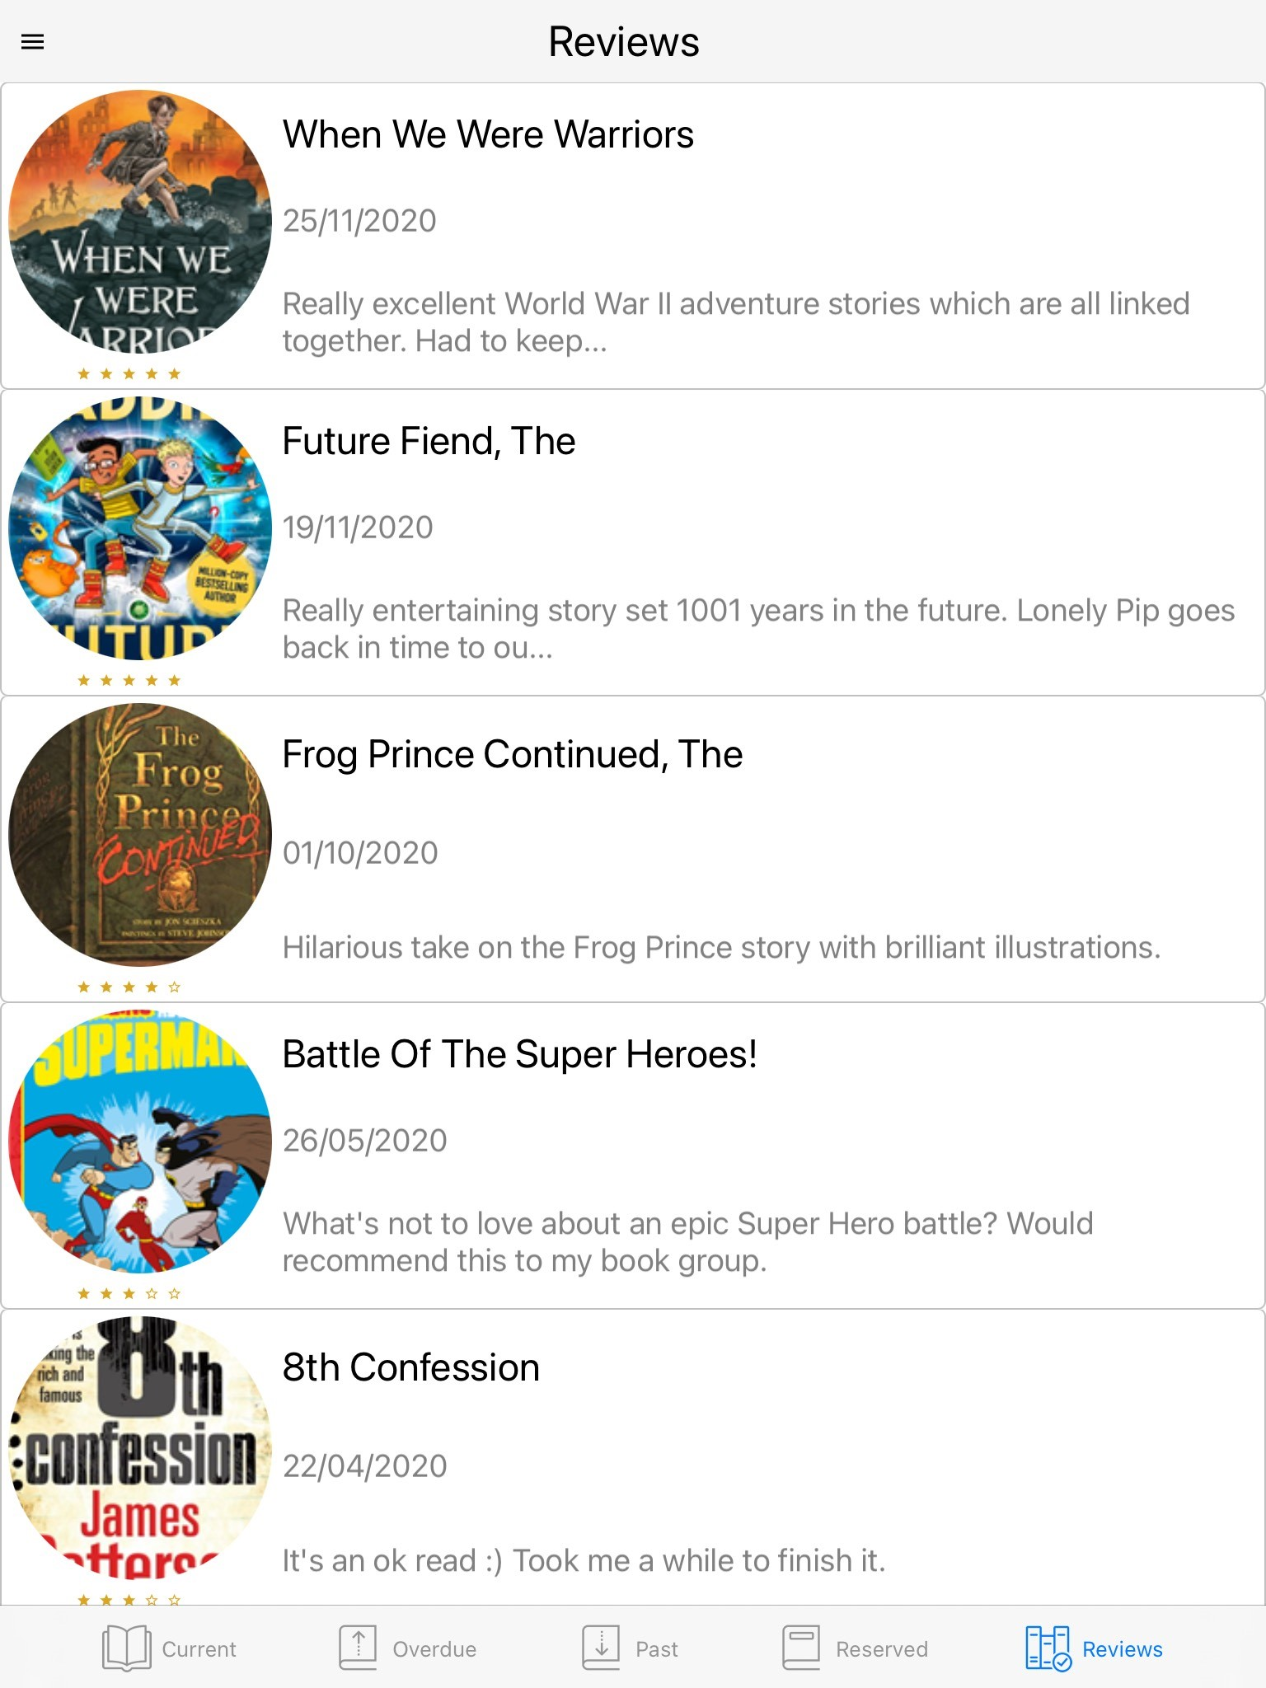
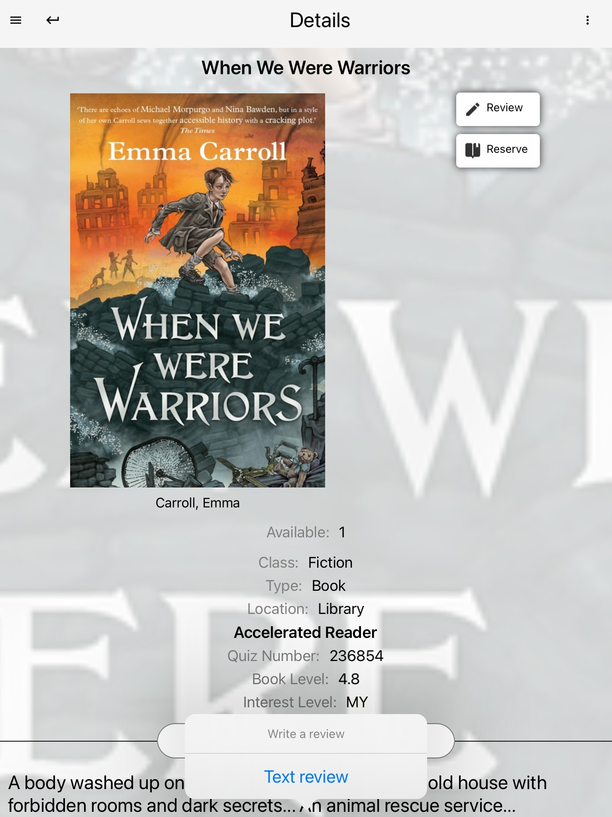
Book Reviews
Read a good book?
Write a review.
This can be done using the App or webpage. Your review will then appear within My Account and when approved by your librarian will be shown in Latest Reviews.

Slide 11
Questions?

Slide 12
Questions
# How will I get my books?
Miss Williams will bring any reserved books to your form room. Please make sure you check the availability on the book, if it has already been reserved by someone else you will be put on a waiting list.
# How many books can I reserve?
You can reserve up to 4 books.
# How long can I keep my books?
You can keep your books for up to 2 weeks.
# What do I haven’t finished my book after 2 weeks?
You can either come to the library, renew your book online or email denise.Williams@mar.mmat.co.uk to request more time.
# It wont let me reserve a book?
You may already have the maximum number of books on you account or you are trying to reserve a book with an age restriction e.g Y7 can not reserve a Y9+ or Y11+ book. See Miss Williams.
# What do I do if I have lost/damaged a book?
Come and talk to Miss Williams.

Slide 13
Any questions or issues, please see Miss Williams in the Library or send me a message on teams.

