Slide 1
Name
School
Form

Slide 2
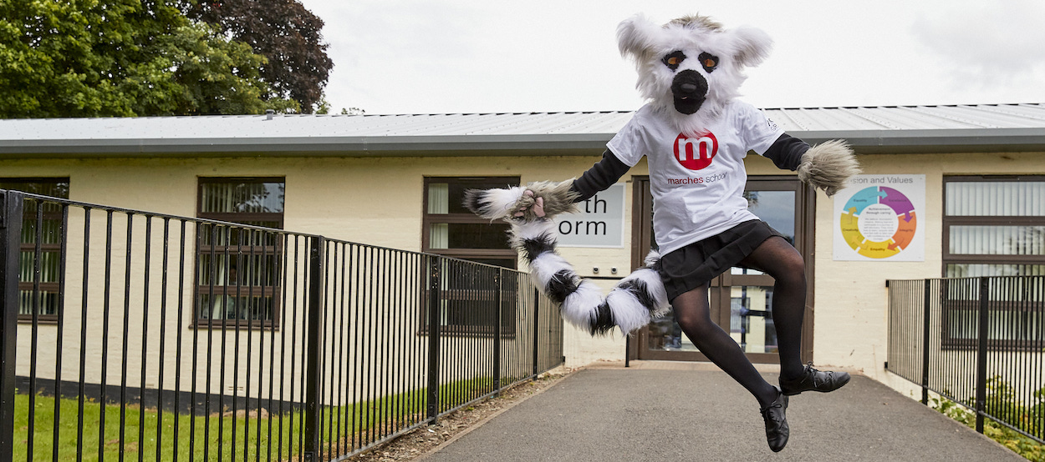
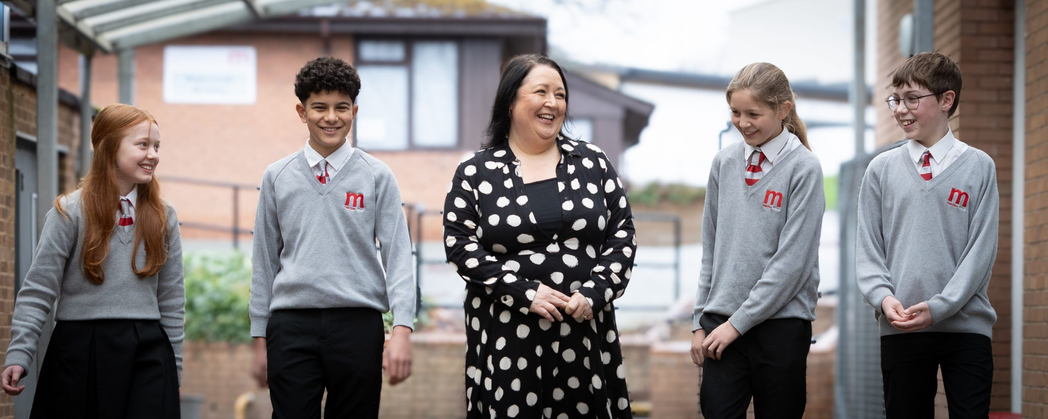
Marches School
Moving from Primary to Secondary School is an exciting, but sometimes scary time! A new building, new rules, new teachers, new routines and new friends are just some of the changes you will experience but this booklet will help you get used to some of the routines and features of your new school!

Slide 3
Life is a journey! Think back through primary school and write down your favourite memories or events that have shaped you to become the amazing person you are!

Slide 4
At your transition days you will be using this information to write a letter to your teachers.
Name:
Birthday:
My Primary School:
Eye Colour:
Hair Colour:
Height:
Draw a self portrait here.
What languages are spoken at home?
Do you care for anyone at home?
Favourite Colour
Favourite Animal
If I could have a superpower, I’d….
Favourite School Subject
Best place I’ve ever been to…
Dream country to visit…
If I could travel back in time, I’d go to…
My dream job is…

Slide 5
List 4 things you are most excited about moving to The Marches
List 4 things you are a little worried/nervous about at The Marches
List 4 things you would like to know about The Marches
List 4 things that will help you when moving to The Marches
List 4 differences between your primary school and The Marches

Slide 6
Transition days
Welcome to The Marches
Who is my form tutor?
Where is my form room?
Notes:
Complete with pupils

Slide 7
Full Name of the School
School Address
School Telephone Number
Name of the Head Teacher
School Starts at
School Finishes at
I will get to school by
How long will it take you to get to school?
What time will you have to leave home?
What do you think these letters stand for?

Slide 8
Expectations at The Marches
Our SMART/LORIC Expectations Policy applies to the way we choose to conduct ourselves, the way that we behave towards other people, and the way that we behave in our lessons.
They are expectations, because we are expected to behave in this way..
Discuss which are rules and which meet the values above!
Saying good morning to people as you pass
Supporting others
Holding the door open for a teacher
Having all your equipment
Consistent punctuality over the whole year
Being respectful of other peoples beliefs
Having your shirt tucked in neatly
Working successfully as part of a team
Going above and beyond with your work
Staying calm if something goes wrong
Being respectful to other staff and students
Sitting with someone who is alone at lunch
High level of respect shown to all
Contributing to lessons
Discussing issues with a teacher
Remembering your homework
Giving someone a compliment
Asking for help when needed

Slide 9
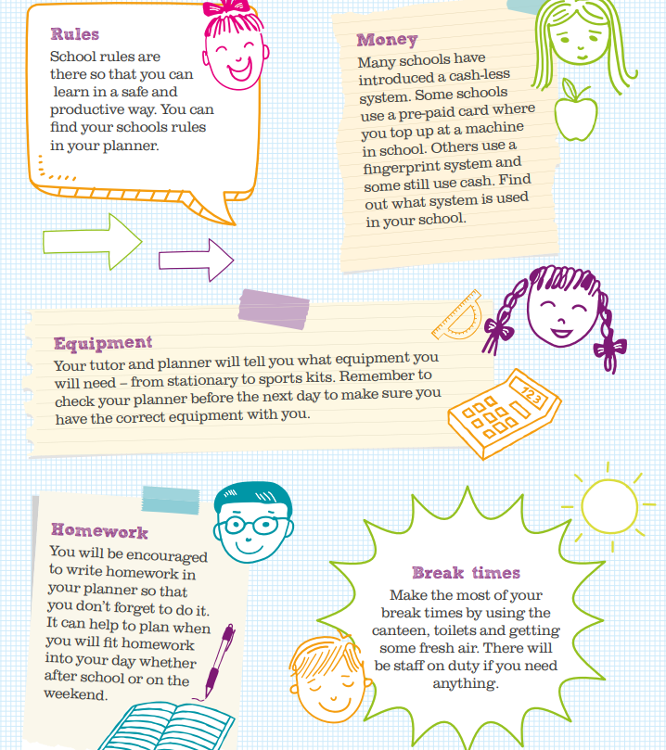

Slide 10
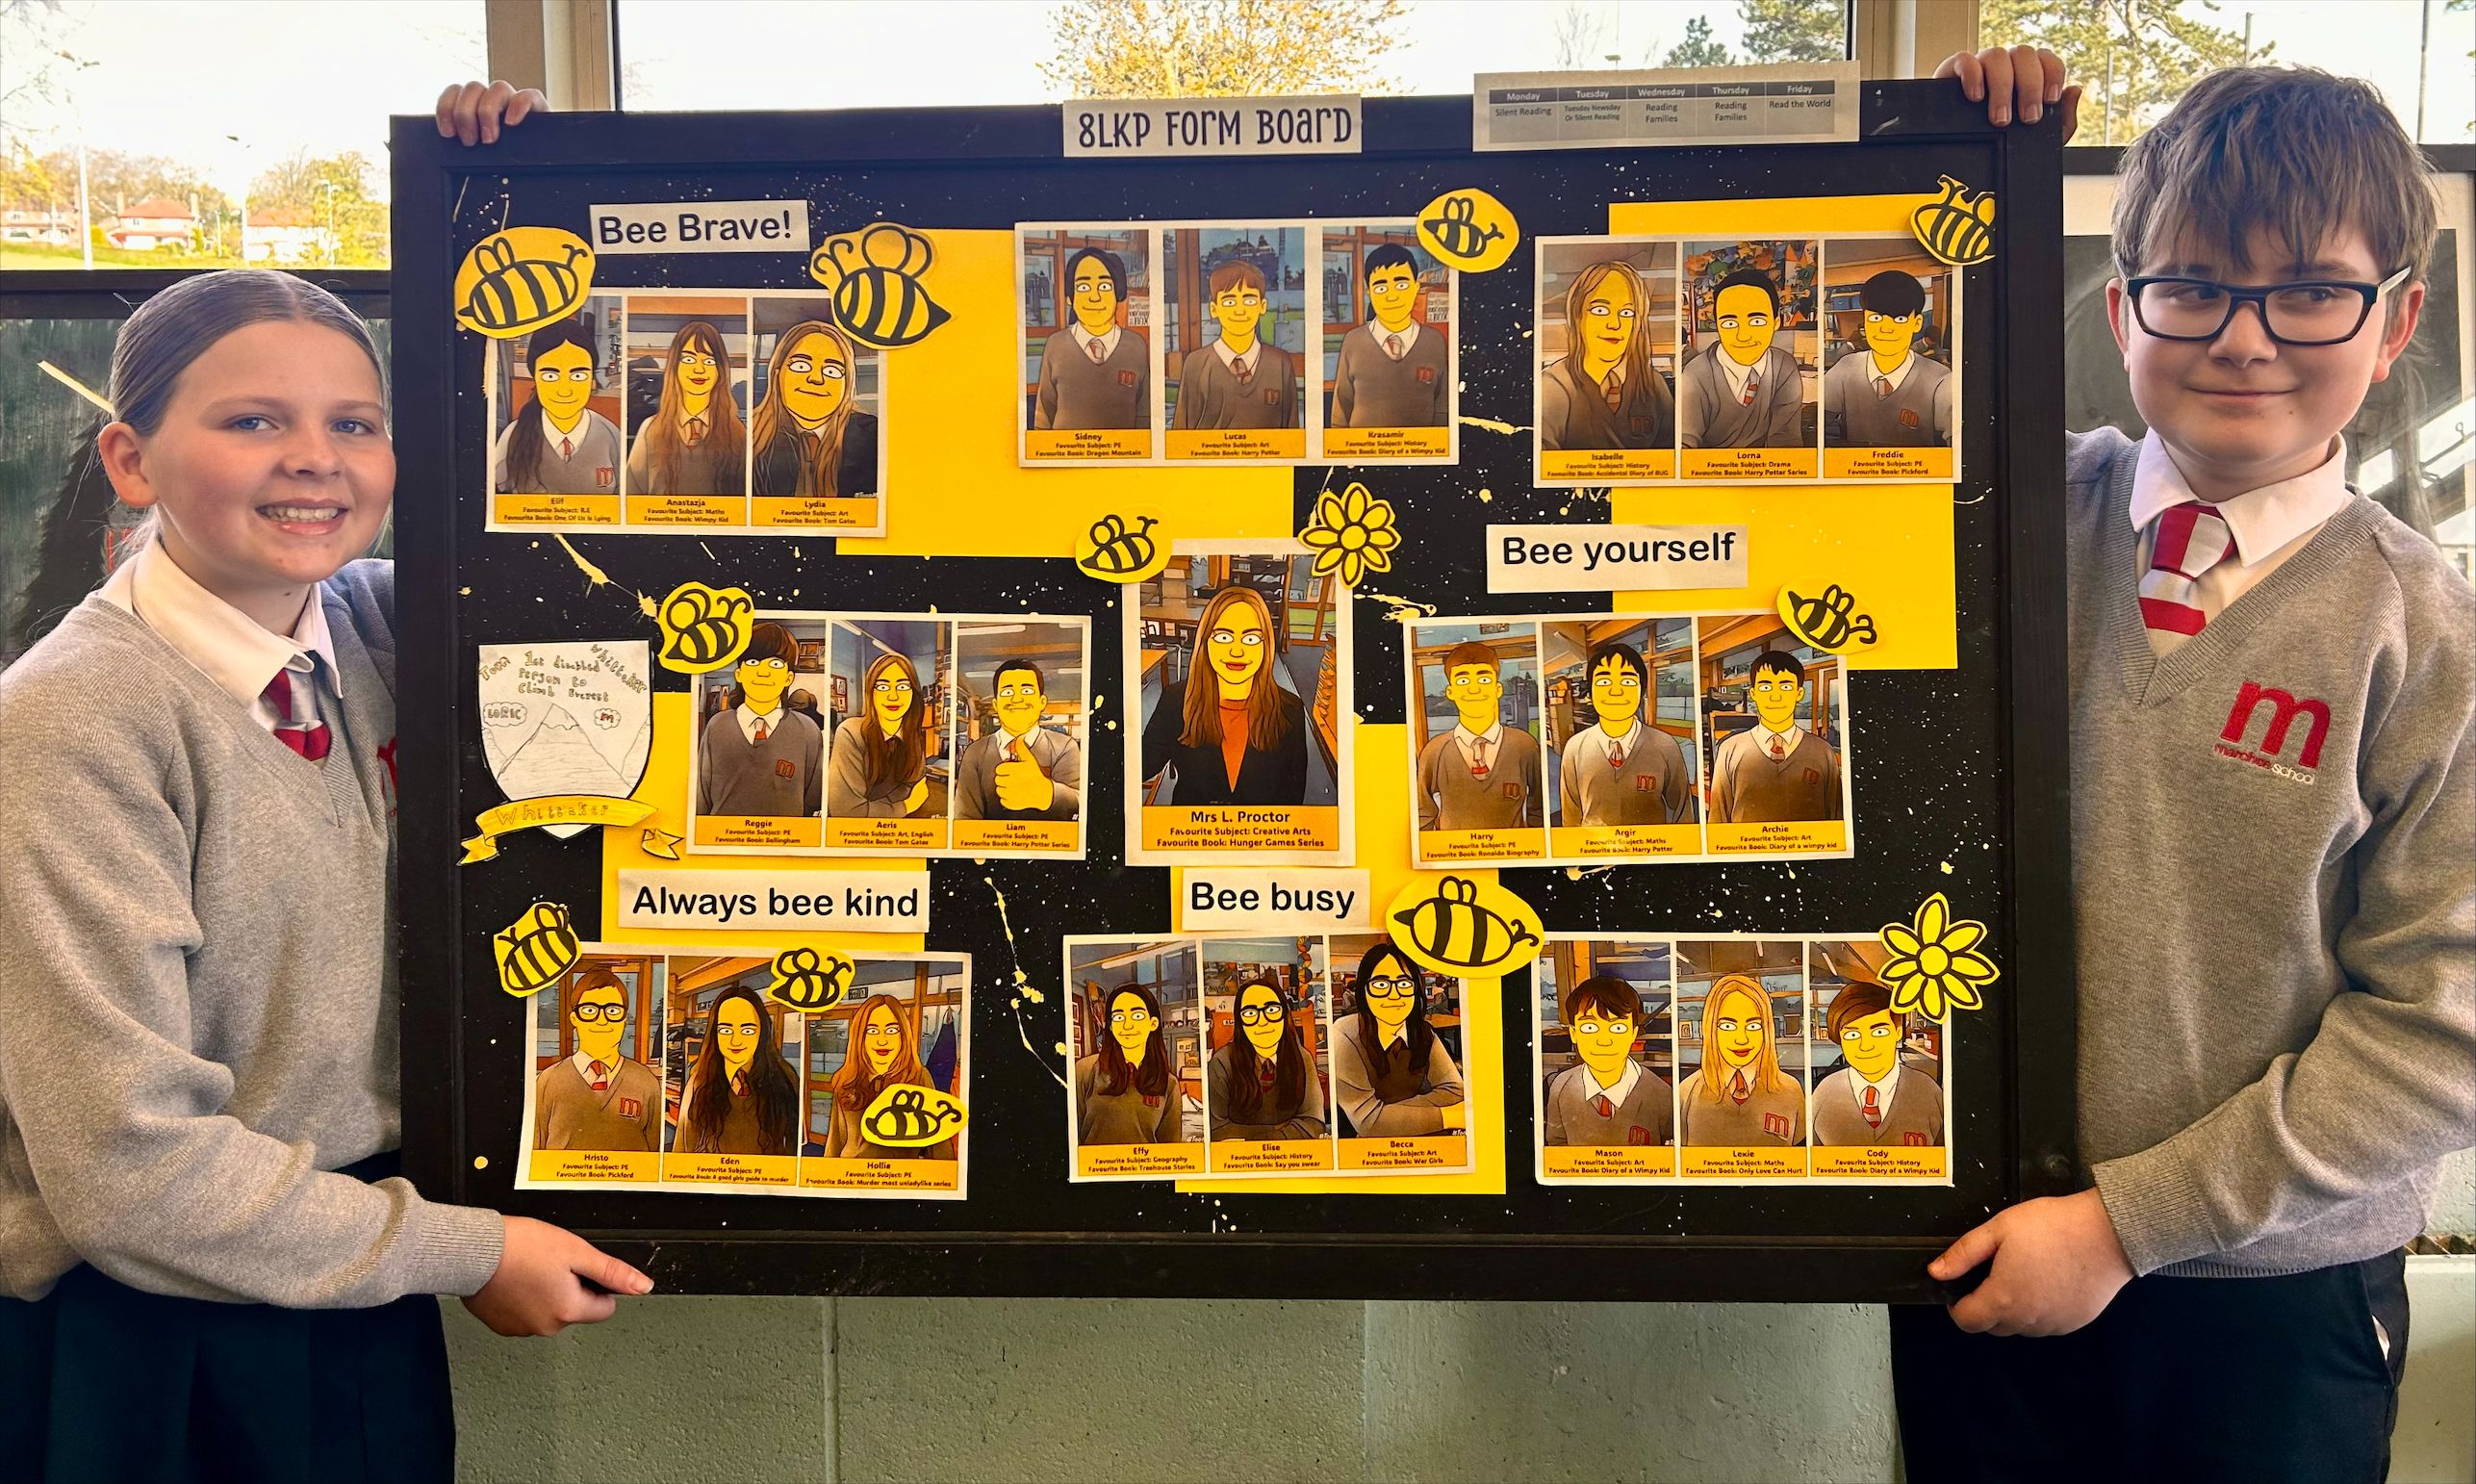
Match up the subject to the correct icon
Maths
English
Science
Geography
History
PE
Creative Arts
Performing Arts
Computing/ICT
PRE
MFL
Tutor Time
Reading time

Slide 11
At secondary school, you will be moving around to different classrooms for different lessons. This means that you need to bring all the equipment you will require with you for the day. You can keep larger items such as your PE kit in your locker, however you can only go to your locker before school, at break and lunchtime and at the end of the day. Below are some items you will need to bring – can you identify them and add anything else?
Pens
Pencils
Ruler
Rubber
Protractor
Compass
Calculator
White board pen
Water bottle

Slide 12
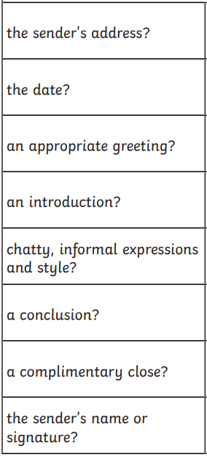
We can’t wait to meet you, but we would love to know a bit more about you first! You should include in your letter:
Your name, age, primary school and an interesting fact about yourself.
Something that you are looking forward to about moving to The Marches and something that makes you feel nervous.
Something you would like us to know about you.

Slide 13
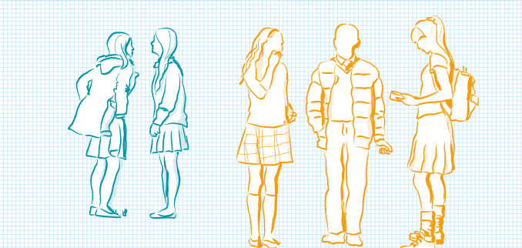

Slide 14
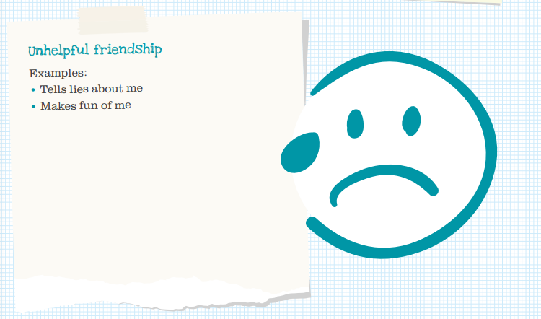

Slide 15
Find the subjects below in the Word search – they are vertical, horizontal and diagonal!
M | A | F | S | E | H | M | G | E | O | H | I | M | J | E | E | A
F | M | A | M | W | S | L | U | S | M | I | S | E | T | T | I | S
R | U | D | A | N | C | E | Z | S | A | C | P | N | U | H | A | I
A | F | G | T | R | D | P | W | R | I | I | A | G | T | I | N | U
H | S | R | H | P | G | R | T | E | N | C | I | T | O | C | A | O
J | T | A | S | L | U | B | N | Y | R | A | N | E | R | S | S | L
T | U | B | J | E | I | C | Q | L | E | R | M | X | T | A | S | S
E | E | A | U | H | E | M | U | A | H | S | U | D | I | N | E | P
N | F | X | L | G | E | O | G | R | A | P | H | Y | M | D | M | A
G | I | M | T | V | M | A | I | T | Y | E | O | A | E | M | B | N
L | O | A | I | I | O | T | O | H | R | T | T | S | C | O | L | I
I | P | T | E | E | L | G | R | D | U | O | E | R | A | R | Y | S
S | P | U | F | O | S | E | E | K | R | M | P | T | T | A | E | H
H | I | S | T | O | R | Y | S | C | S | A | S | M | E | L | R | A
E | N | J | V | E | P | I | F | J | N | O | M | U | R | S | B | K
J | K | C | A | T | E | R | I | N | G | C | N | A | R | P | U | M
Y | Z | X | T | L | S | V | Z | C | O | M | P | U | T | I | N | G
Maths
English
Science
Geography
History
Art
Music
PE
Drama
Textiles
Catering
Computing
Spanish
Assembly
Tutor Time

Slide 16
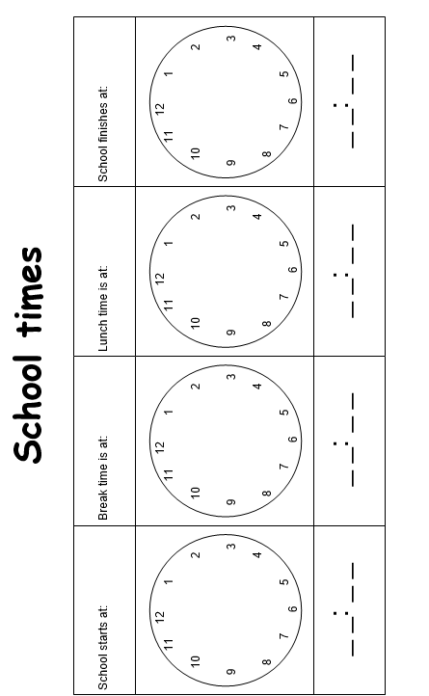

Slide 17
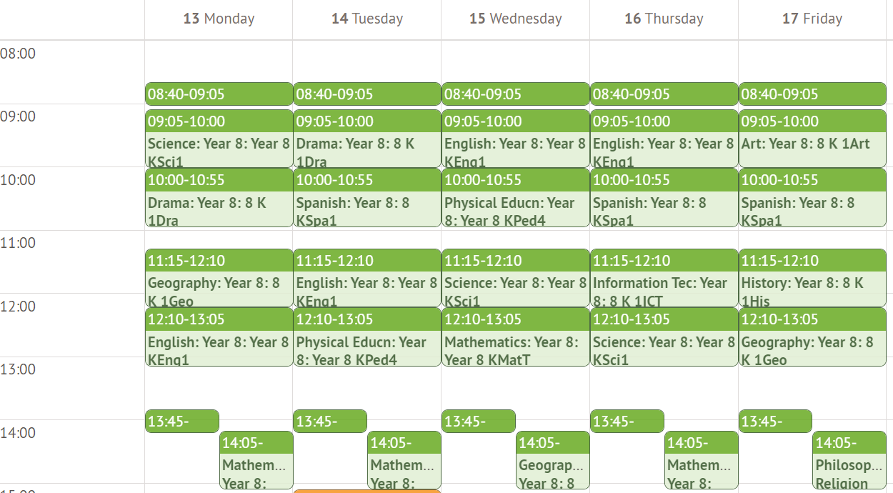
What lesson do you have at 14:05 on Thursday?.......................................
When do you have science? ………………………..
How many minutes does each lesson last? …………………………………
How long is tutor time? …………………………………………………………..
How long is lunch and break combined? …………………………………...
When is PE ? ……………………………………………………………..
How many times a week do you have the following:
Maths: ………………………………..
English: ……………………………….
History: ……………………………….
Which days will you need your PE kit ? ………………………………………………………………………………

Slide 18
Getting to The Marches safely is just as important as being there. In the box below, draw the route you are going to take to school (whether that’s walking, cycling, driving or by bus). Identify spots where there could be hazards (e.g. busy roads) and explain how you will manage this safely!

Slide 20
One of the different things about moving to secondary school is the change in what you will wear. At The Marches, we pride ourselves in looking smart and professional at all times. Use the school website or the information booklet to draw and label the school uniform you will wear onto the Lego figure
Why is wearing the correct school uniform important?
…………………………………………………………………………………………………………………………………………………………………………………………………………………………………………………………………………………………………………………………………………………………………………………………………………………………………………

Slide 21
Marches Uniform
Branded items that are required:
Grey v neck jumper
School striped tie
Branded PE polo shirt
Non branded items that are required:
Black school trousers
Black pleated school skirt
Black tailored school shorts (summer term only – optional)
Hair
Extreme hair styles including tram lines or unnatural colours are not permitted – hair length should be a minimum of a “number 2” in length on the top, but may fade out to shorter length on the sides. Fashion hair accessories such as bows or flowers and baseball caps should not be worn.
Makeup
Makeup is not permitted in Key Stage 3 (Years 7,8 and 9). At Key Stage 4 (Years 9 and 10) makeup should be modest –nude and natural colours.
Coloured in or painted on brows are not permitted. Nail polish, false nails and/or false eye lashes should not be worn at Key Stage 3 or 4.
Jewellery
Only one plain ear stud in each ear is permitted. No rings are allowed. Stretcher or flesh ring style earrings must be flesh coloured and flat to the ear.
Belts
Belts may be worn if black and being used for its functional purpose not for fashion and not visible below of on top of the jumper.
Piercings
Visible facial or body piercing including tongue piercings may not be worn unless worn as an aspect of a clearly identified religious faith.

Slide 22
PE kit
Branded items that are required:
Branded PE polo shirt
Non branded items that are required:
Plain black shorts or “skort” (no logos)
Plain red football socks
Football boots (boys only)
Trainers (not pumps)
Shin guards
Mouth guard (strongly advised for hockey and rugby)
Optional items:
Kit Items you may wear for PE Lessons:
Long sleeved black base layer
Plain black tracksuit bottoms
Plain black sports leggings – at KS3 to be worn under skort, Plain black unbranded jumper (not hoodie) worn for PE

Slide 23
My first day Class of 2029
Check list
Pencil case
Planner
PE kit
Coat
Is everything labeled?
Reading book

Slide 24
When you go to Secondary School, you will learn a huge number of new skills, and improve skills you have practiced in Primary School. In the goal below, use the list to write in 10 new skills or things you’d like to build on in your years at Secondary School.
Be in a school play or production | Speak another language | Represent your school in a national competition
Learn to play a musical instrument | Volunteer in the local community | Travel to another country
Play for a school team | Learn how to survive in the wild | Take care of the school garden
Learn how to manage money | Taste food from another country | Walk the school dog
Cook a new meal from scratch | Read new books | Take part in a fancy dress day
Create a piece of art | Raise money for charity | Become Head Boy or Girl
Learn how to read a map | Join an after school club | Learn to dance
Use computers to create your own website | Learn First Aid | Improve your singing
Make new friends from other schools | Work as part of a team | Try camping

Slide 25
After secondary school, you can move onto The Marches 6th form/college or an apprenticeship and then to University or into a job! It’s normal not to know what you want to do yet, but this is a chance for you to have a think about your dream jobs!
Icons to represent that job:
Icons to represent that job:
Icons to represent that job:

Slide 27
Where to go for support
The SHARP System:
SHARP stands for Student Help Advice Reporting Page. The SHARP system allows young people to report any incidents which occur within the school and local community anonymously and without fear. Visit the SHARP System to submit a report.
Teentips Wellbeing Hub can be accessed here.
Wellbeing support services for children, young people and parents/carers:
Beam are an emotional health and wellbeing drop-in service for young people under 25 years old who are registered with a GP in Shropshire, Telford or Wrekin. Their team of experienced wellbeing practitioners and volunteers will listen to whatever is troubling you; recommend strategies and techniques that aim to make life easier; give practical suggestions and advice and provide a listening ear if you have something you want to get off your chest.
Kooth offers free online mental health and wellbeing support to young people aged 11-25 years in Shropshire, Telford & Wrekin via any internet accessible device. Kooth provides an opportunity to interact in a supportive way with other young people as well as receive support from a team of qualified counsellors.
Young Minds has information, tips and advice to help improve emotional health and wellbeing of children and young people in the UK. Whether you want to understand more about how you’re feeling and find ways to feel better, or you want to support someone who’s struggling, they can help.
Samaritans whatever you’re going through, a Samaritan will face it with you. If you need someone to talk to they will listen without judgement or pressure. They are there 24 hours a day, 365 days a year. Samaritans can be contacted on 116 123 for free.
STEM 4 provides support with mental health specifically for teenagers. They have lots of advice about anxiety, depression, self-harm, eating disorders and addiction. On their website you can also access a comprehensive library of free mental health resources.
Childline offers advice about a wide range of issues. They provide a free, private and confidential service where you can talk about anything. They are available for you online, on the phone, anytime day or night – 0800 1111.
The Mix is the UK’s leading support service for young people. They are there to help you take on any challenge you’re facing – from mental health to money, from homelessness to finding a job, from break-ups to drugs. Talk to them via their online community, on social, through their free, confidential helpline or their counselling service.

Slide 28
LGBTIQ+ Mental Health the charity Mind has lots of information about mental health support for people who are lesbian, gay, bisexual, trans, intersex, queer or questioning (LGBTIQ+). Visit their website here to find out more.
Togetherall is a safe, online community where people support each other anonymously to improve mental health and wellbeing in a welcoming and safe environment. The platform promotes a sense of belonging and connection through community. Accessible anywhere, anytime, 24/7.
U&I Counselling Oswestry is an organisational member of the BACP. They fit the therapy around the client rather that the client into a therapy model which offers each client an individual personal experience that supports their need. Referral to U&I can be via a doctor, agencies or people can make direct contact concerning specific or multiple issues. It is a confidential professional service available to young people, individuals, couples and families. Flexibility allows short or long term face to face work. Many of their counsellors have specialised training in schools and young peoples counselling. You can contact them on 0753 044 8000.
Wellbeing resources:
CAMHS Resources a collection of downloadable self-help guides relating to wellbeing. Some are aimed at adults but the ideas and suggestions in them can still be relevant for young people and parents.
Mind as well as offering support, the Mind website outlines some practical steps you can implement to support your wellbeing during the coronavirus pandemic.
Mental Health UK has a number of downloadable resources which includes conversation guides, plans and booklets.
Additional support services:
Autism West Midlands offers a specialist service, providing support for adults and children with autism. Their helpline welcomes calls from parents, autistic adults, carers and professionals who live in the West Midlands to discuss concerns they have about autism (before and after diagnosis). Callers will find experienced, understanding staff who offer a listening ear and who can provide information about autism and local support services.
Parents Protect is an organisation that has developed an online child sexual abuse and exploitation awareness learning programme for parents/carers to help: Understand potential risks; recognise the signs of possible abuse; be aware of inappropriate behaviour in adults and to know where to go for help if you have concerns and would like to talk about them.
Shropshire Safeguarding Community Partnership children’s website designed to provide useful information and advice for professionals, parents and children. They coordinate and monitor how the services and professional staff work together to protect children from abuse or neglect.
Shropshire Larder this resource is the most comprehensive directory of services for people living in Shropshire on a low budget. It has information on how to access a foodbank or community food project and how to eat well on a budget. It also covers how to get support with benefits, housing and debt. Shropshire Larder | Shropshire Food Poverty Alliance
Find a local Foodbank – Food banks are grassroots, community organisations aimed at supporting people who cannot afford the essentials in life. Visit The Trussell Trust to find your nearest foodbank.
Carers Trust advice for young carers. A young carer is someone under 18 who helps look after someone in their family, or a friend, who is ill, disabled, has a mental health condition or misuses drugs or alcohol. Carers Trust helps young carers to cope with their caring role through specialised services delivered by Carers Trust Network Partners across the UK.

Slide 29
